Slide 1
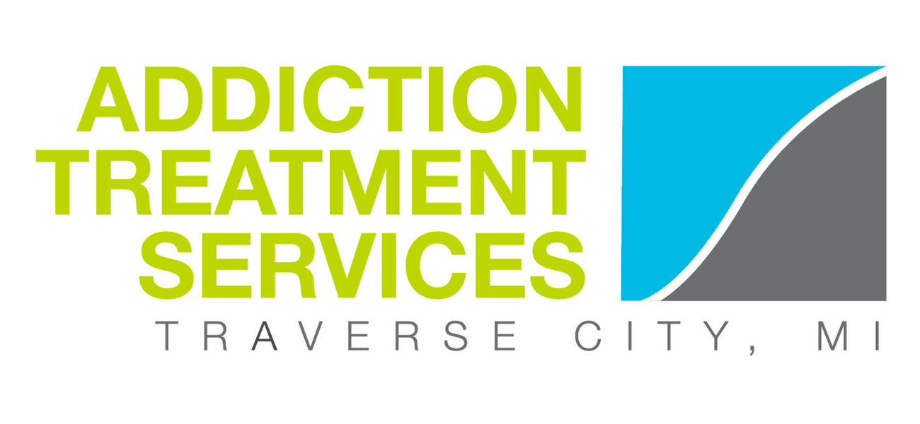
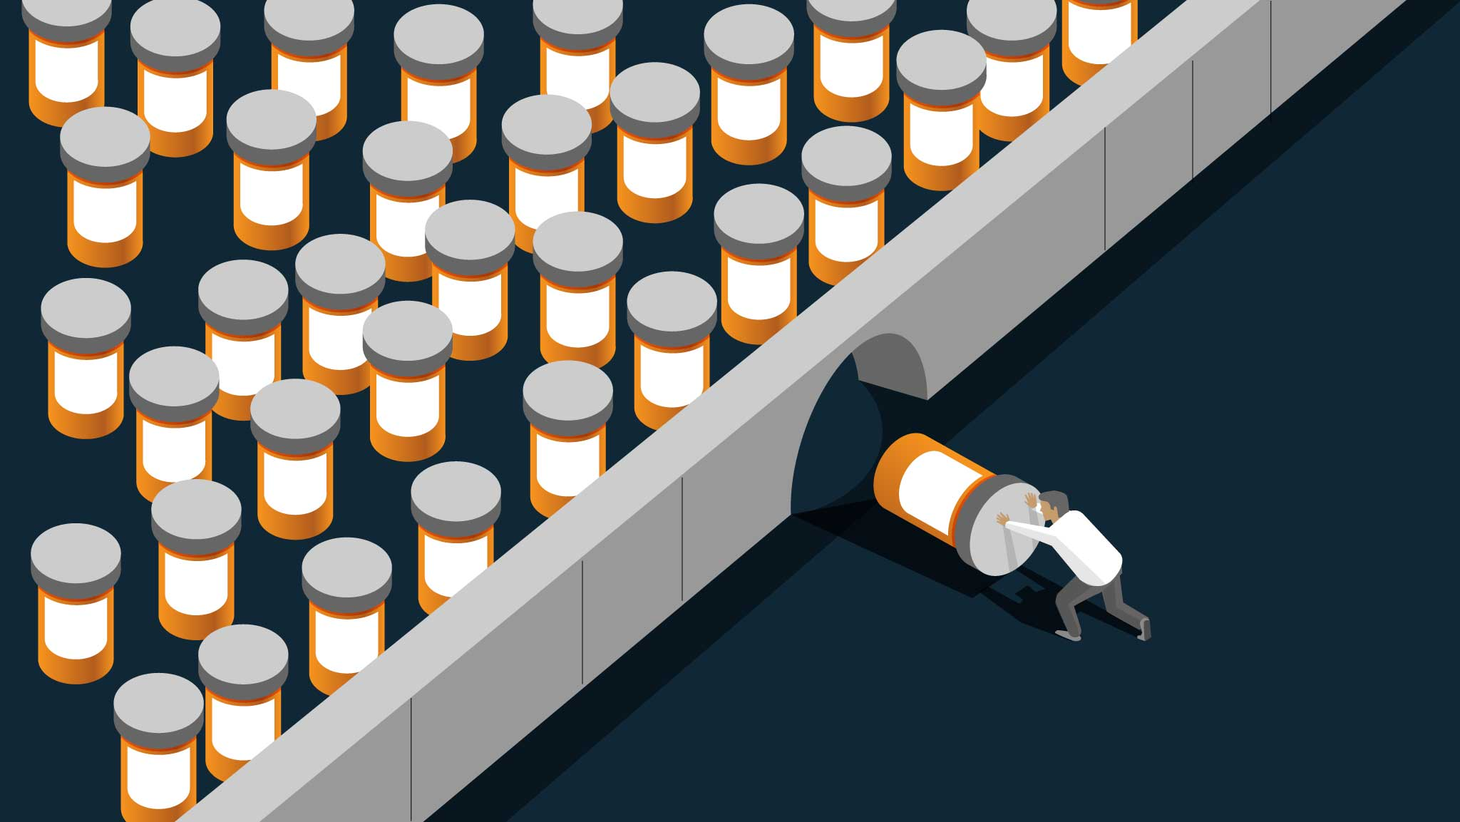
Opioids and Our Community

Slide 2

Who We Are
We are doctors, therapists, case managers, social workers, chefs and more! From vastly different backgrounds, we came together with something in common: we’ve all been affected by addiction in some way, and we all want to build a healthier community. Each of us is wholeheartedly dedicated to supporting people who are working to overcome addiction and maintain a recovery lifestyle.
Our mission is to promote the overall health, wellness, and recovery of individuals impacted by substance use and behavioral health issues by meeting the treatment needs of our clients and community.

Slide 3
What We Offer
• The PIER - Detox for Drugs and Alcohol
• Residential Services for Men and Women
• Recovery Homes for Men and Women
• Outpatient Services
• Intensive Outpatient
• Assessments
• The PORCH - Community Resource Center
• Treatment Groups
• Therapy
• Medication-Assisted Treatment

Slide 4
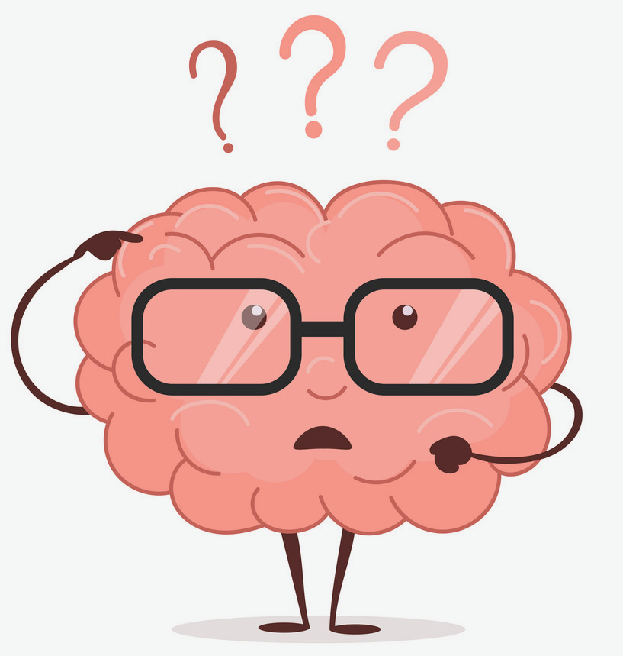
What is Addiction?
Addiction is a primary, chronic disease of brain reward, motivation, memory and related circuitry. Dysfunction in these circuits leads to characteristic biological, psychological, social and spiritual manifestations. This is reflected in an individual pathologically pursuing reward and/or relief by substance use and other behaviors.
Addiction is characterized by inability to consistently abstain, impairment in behavioral control, craving, diminished recognition of significant problems with one’s behaviors and interpersonal relationships, and a dysfunctional emotional response. Like other chronic diseases, addiction often involves cycles of relapse and remission. Without treatment or engagement in recovery activities, addiction is progressive and can result in disability or premature death.

Slide 5
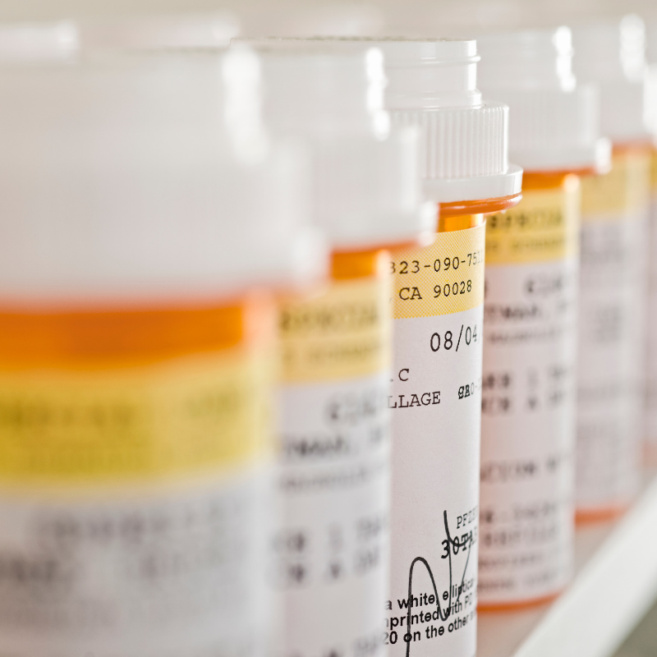
Opioids
Opioids can be prescribed and can also be illicit. You might not realize this, but if you have had a sports injury, dental work, or surgery, it is possible your doctor gave you a pain reliever that was actually an opioid medication. While opioids can be very effective at treating pain, they can be very addictive and should only be used under a doctor’s careful watch.
In addition to opioids given to you by a doctor, there is another kind of opioid you have probably heard about called heroin. Heroin is a very dangerous drug that is usually used by injecting it directly into a vein with a needle. The chemical makeup of heroin is the same as that of pain relievers and both can be very addictive and cause deadly opioid overdoses. In fact, 2.14 million people ages 12 and older had an opioid use disorder in 2016, including 153,000 12- to 17-year-olds.

Slide 6
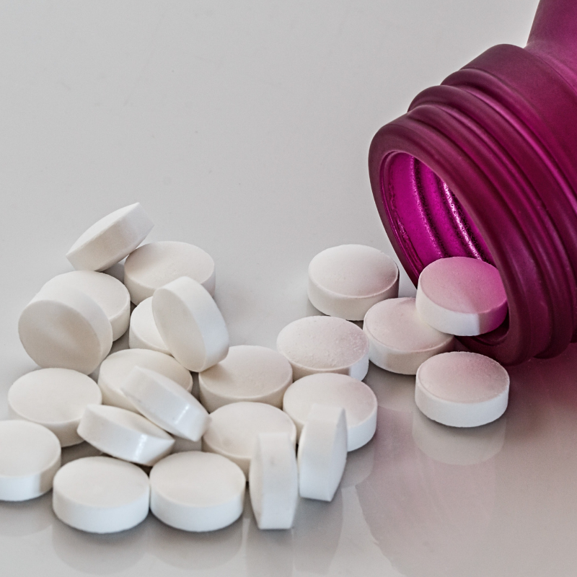
How Opioids Affect the Body and Brain – Short Term
Long-term effects can include:
Nausea and vomiting
Abdominal distention and bloating
Constipation
Liver damage (especially prevalent in abuse of drugs that combine opiates with acetaminophen)
Brain damage due to hypoxia, resulting from respiratory depression
Development of tolerance
Dependence
Death

Slide 7
Opioid Deaths up more than
200% in our Region
The number of Michigan deaths from an overdose of opioids, including heroin, exceeded deaths from traffic crashes or gun fatalities in 2015, according to data from the Michigan Department of Health and Human Services. In 2018, more Americans die from overdoses than car accidents across our nation.
Our community is not free from this epidemic. Across our 5-county region, people are dying. In 2010, only 7 people across our region died from opioid-related overdoses or related disease. In 2017, that number increased over 200% to 67 individuals.
Nearly ½ those deaths occurred in Grand Traverse County, our region’s population center, while more rural counties saw lower death rates.

Slide 8
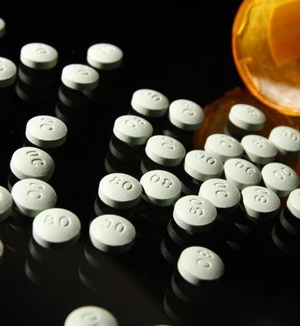
The Addiction Epidemic in Michigan
In the state of Michigan, Opioid overdose rates jumped 54% from 2015 to 2016, killing more than 1,350. Between 2016 and 2017, they increased an additional 35%. Including heroin, opioids accounted for 77% of drug related deaths in our state.
Michigan ranks 10th in per capita prescribing rates of opioids.
The abuse of opioids is not unique to Northern Michigan, but seems to be more of an issue here than in other parts of the state (per Det. Dan King MSP)
How big is Michigan's issue with opioids? Consider this: Michigan health-care providers wrote 11 million prescriptions for opioid drugs in 2015 and another 11 million in 2016 -- enough to provide every Michigan resident with his or her own bottle of narcotics, according to state data. Prescribing laws changed in 2018 with doctors being able to prescribe 7 days for acute pain and 30 days for chronic pain.

Slide 9

The Addiction Epidemic Across the Nation
2016, more than 64,000 people died of drug overdoes across our nation
91 Americans die each day from opioid overdoses and the number is growing
Cost of $56 billion annually for pain management, healthcare costs, work loss, legal system
Prescription drugs are the second-most abused category of drugs only behind marijuana
21 million Americans have a drug or alcohol related addiction

Slide 10
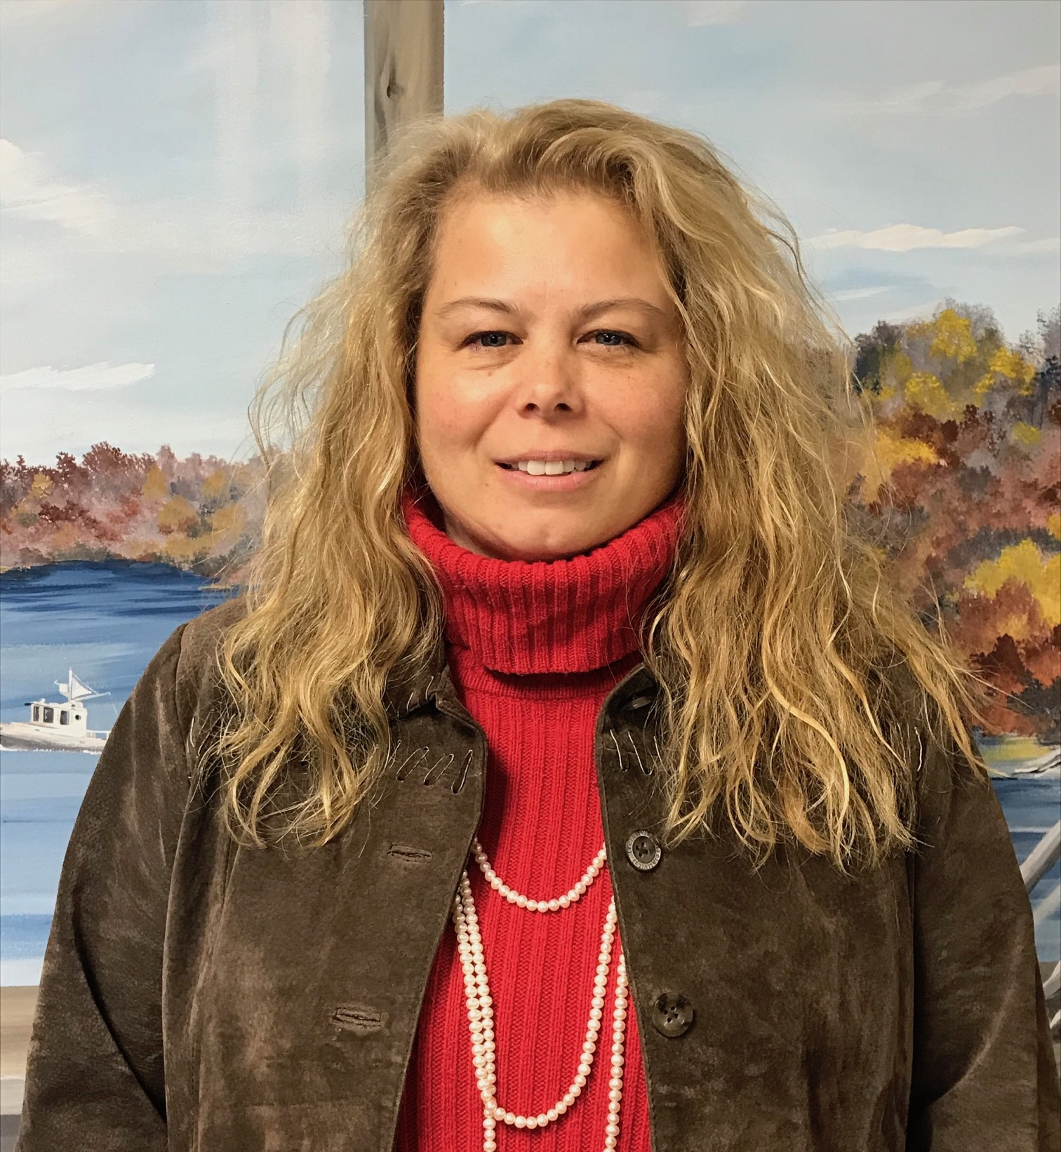
Suzanne Prentice
A personal story of the struggle with addiction
“I am the mother of an Addict. Those are hard words to say sometimes. My once bright eyed, quick witted, and intelligent child became highly dependent on drugs. This wasn’t supposed to happen to us. We were a church-going Military family. He had two parents and a brother that loved him dearly. We weren’t perfect, but we sure tried. I think we lost him to drugs from the combination of depression from bullying, predisposition, and the prescribed opioids as a young athlete. But who can really say? All I know is It’s been 14 years of stomach-wrenching, roller coaster rides filled with so many nights on the floor, begging God to save my son. I am only one of millions of parents that live this nightmare. There have been far too many lives lost in our small community. I believe through well-planned programs we can help to save lives, support families, provide preventative education, as well as educate the public to the truth about addiction; breaking the stigma that isolates families. I believe together our communities can make a difference.”

Slide 11
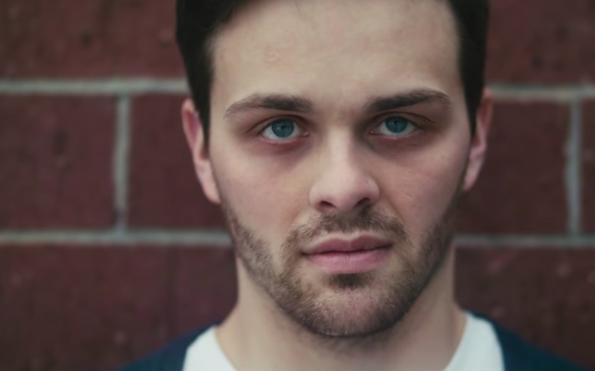
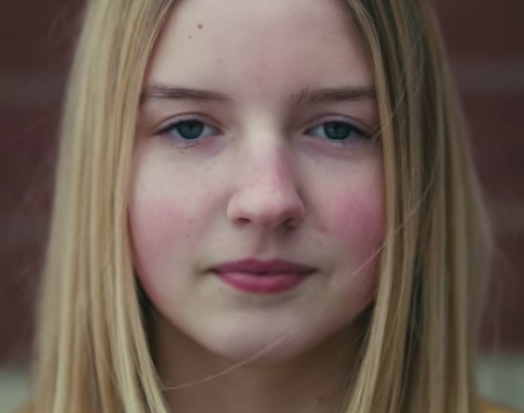
Predator & Prey
In 2018, Alex Grizzel, a local young man, lost his life to an overdose. His family wanted to do something about educating the community. Through their efforts and outreach, Predator & Prey was born. East Middle School Students and teach Jody Mackey created an 18 minute documentary about the local impact of the opioid crisis.
Addiction Treatment Services wrote an accompanying discussion guide for the film that is available to anyone in the community and beyond.
View the documentary:
www.predatorandprey.org

Slide 12

Thank you!
Contact Me:
Kate Kerr, Director of Communications & Outreach
Addiction Treatment Services
1010 S. Garfield Ave., Traverse City, MI 49686
katek@addictiontreatmentservices.org
Phone: 231.346.5218 x 204 Mobile: 517.488.8940
www.addictiontreatmentservices.org

