Slide 1



Slide 2
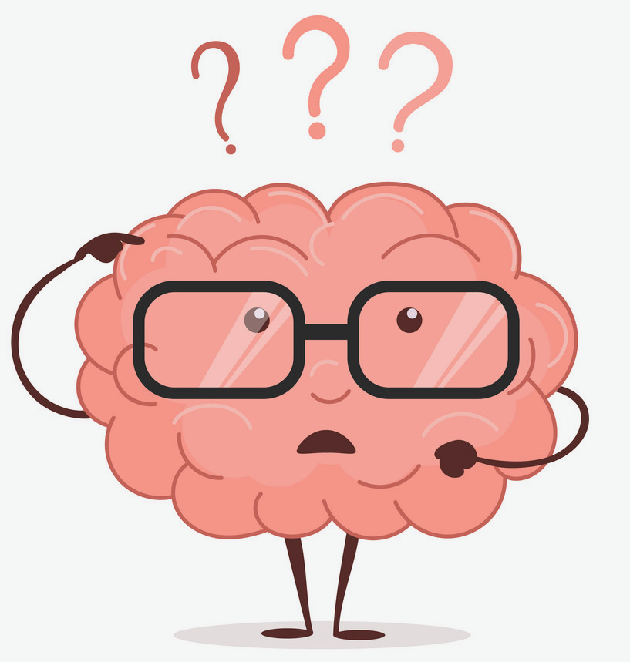
What is Addiction?
Addiction is a primary, chronic disease of brain reward, motivation, memory and related circuitry. Dysfunction in these circuits leads to characteristic biological, psychological, social and spiritual manifestations. This is reflected in an individual pathologically pursuing reward and/or relief by substance use and other behaviors.
Addiction is characterized by inability to consistently abstain, impairment in behavioral control, craving, diminished recognition of significant problems with one’s behaviors and interpersonal relationships, and a dysfunctional emotional response. Like other chronic diseases, addiction often involves cycles of relapse and remission. Without treatment or engagement in recovery activities, addiction is progressive and can result in disability or premature death.

Slide 3

Who We Are
We are doctors, therapists, case managers, social workers, chefs and more! From vastly different backgrounds, we came together with something in common: we’ve all been affected by addiction in some way, and we all want to build a healthier community. Each of us is wholeheartedly dedicated to supporting people who are working to overcome addiction and maintain a recovery lifestyle.
Our mission is to promote the overall health, wellness, and recovery of individuals impacted by substance use and behavioral health issues by meeting the treatment needs of our clients and community.

Slide 4
What We Offer
• The PIER - Detox for Drugs and Alcohol
• Residential Services for Men and Women
• Recovery Homes for Men and Women
• Outpatient Services
• Intensive Outpatient
• Assessments
• The PORCH - Community Resource Center
• Treatment Groups
• Therapy
• Medication-Assisted Treatment

Slide 5
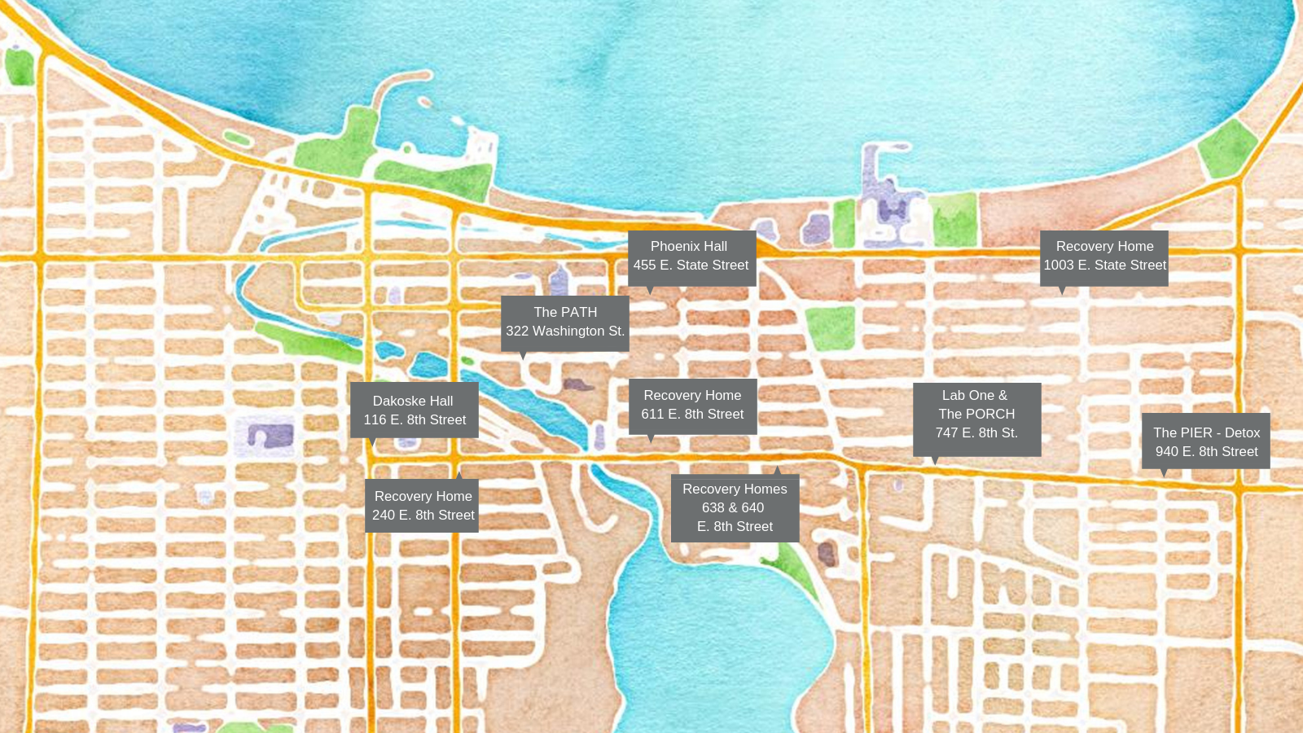
Our Facilities

Slide 6
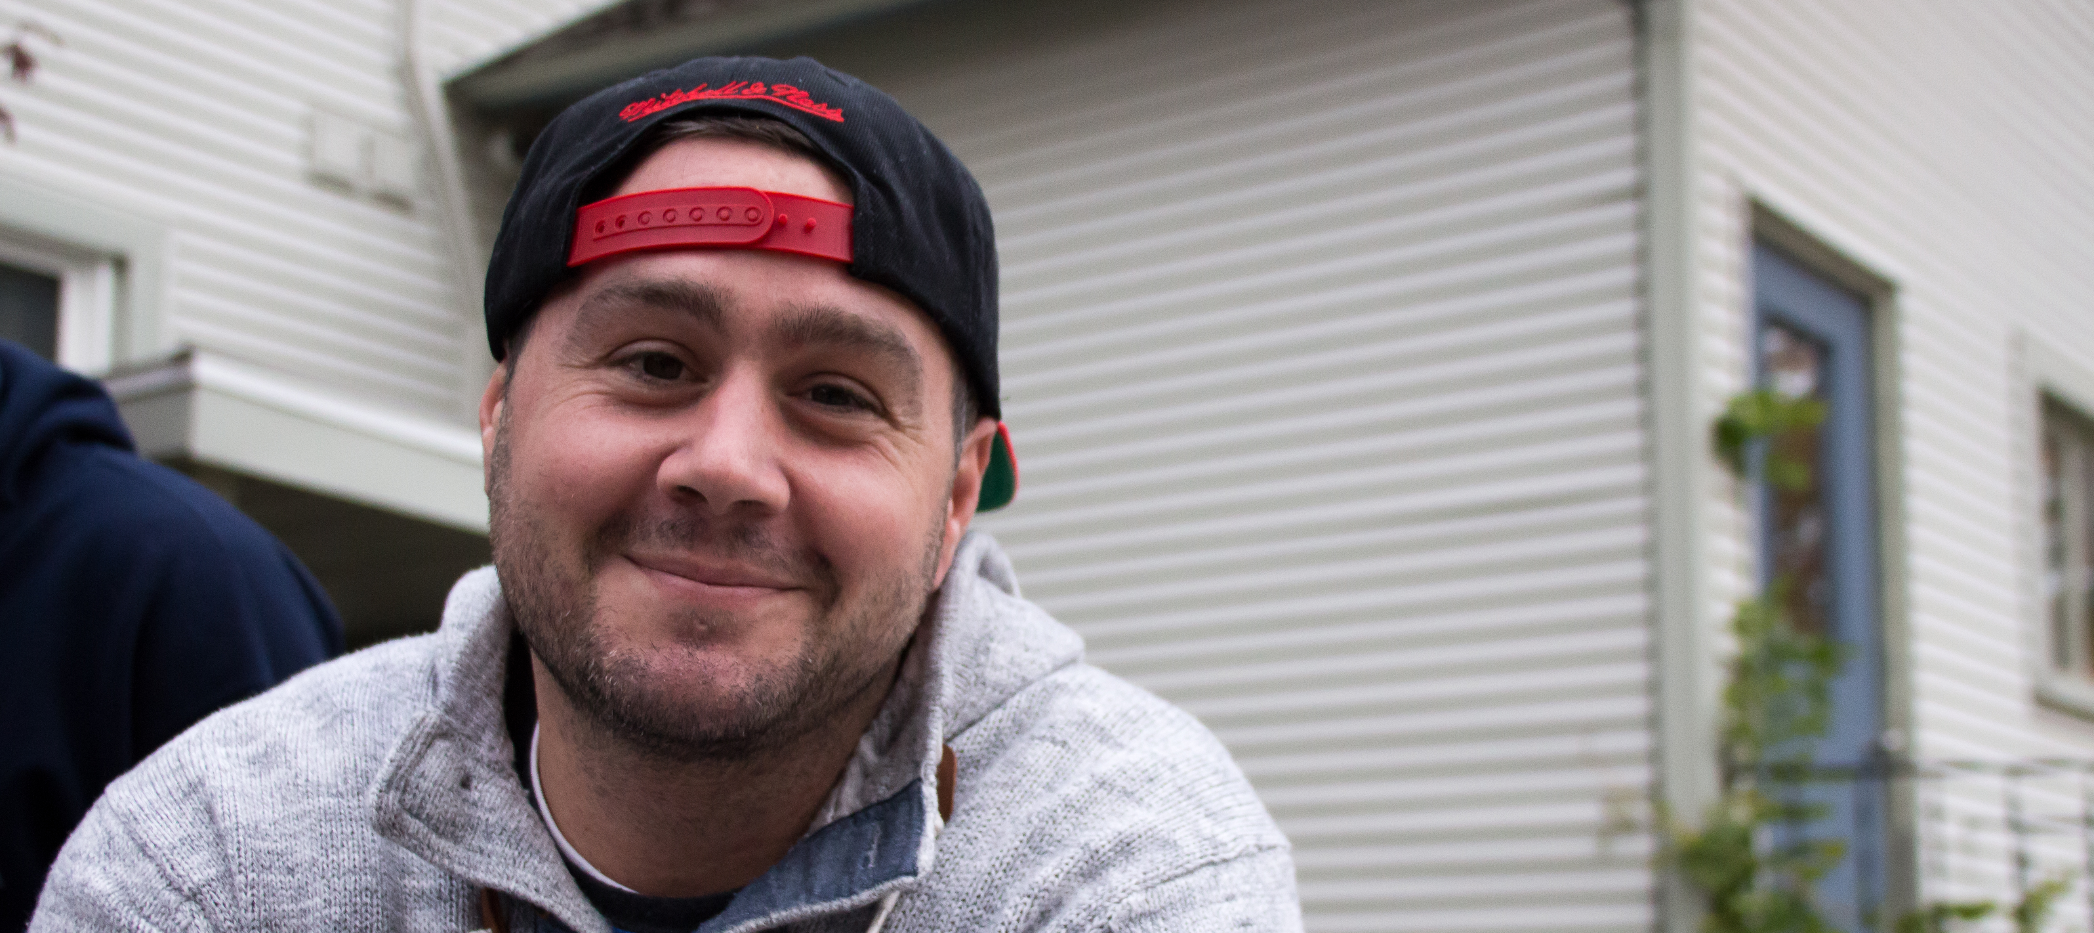
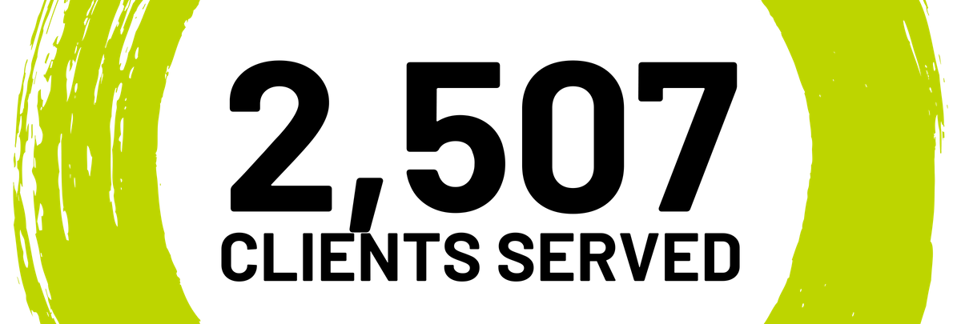
Who We Serve
Our clients are our first priority. Evidence-based care means that they're getting the very best of what we offer whenever they come through the door.
Each year, the clients we serve through our programs and services are the reason we do what we do. Their success equals our success.
Detox: 965
Residential: 534
Outpatient: 755
Recovery Homes: 131
Other: 122

Slide 7
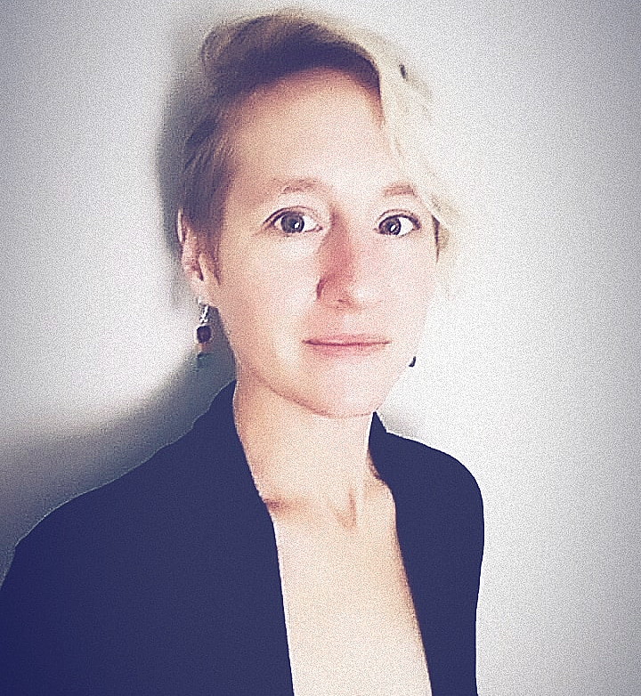
Recovery is Real Meet Kristin Frank
One year ago, Kristin was nearing one year addiction free. She’d found hope through ATS and had begun to transform every aspect of her life - free from the chains of her past. She was starting to experience a life free from shame and full of possibilities. But what was next?
Like many in recovery, the past behaviors and toxic environment were left behind, but the reality of creating a new, healthy, and supportive lifestyle proved challenging. Kristin knew she needed to surround herself with positive, whole-self nurturing people. Taking my cue from a few of the recommendations from staff at ATS, she explored Yoga, meditation, and started a regular exercise routine. She loved the effect of these classes so much that she got her RYT in Yin Yoga and started leading guided meditation meetings.
She joined a few recovery groups to find like minded, encouraging people and in the process formed deep and meaningful friendships. She wrote the story of her past in poems and songs and (with extreme vulnerability) published a poetry book about my trauma, addiction, and recovery. And when Kristin was overwhelmed or felt she couldn't do it anymore, she knew she could reach for support from those at ATS who reminded her that not only COULD she do it, but was ALREADY doing it! In fact, the ever present, whole self-support and care received from day one was so profoundly life changing, that Kristin decided to work for the organization that helped save and transform her life.
Today, she's not only a person in recovery, she's a proud employee of Addiction Treatment Services. Hope keeps happening here. Every day.

Slide 8

Questions?

Slide 9

Thank you!
Contact Me:
Kate Kerr, Director of Communications & Outreach
Addiction Treatment Services
1010 S. Garfield Ave., Traverse City, MI 49686
katek@addictiontreatmentservices.org
Phone: 231.346.5218 x 204 Mobile: 517.488.8940
www.addictiontreatmentservices.org

