Slide 1

Teens & Addiction

Slide 2
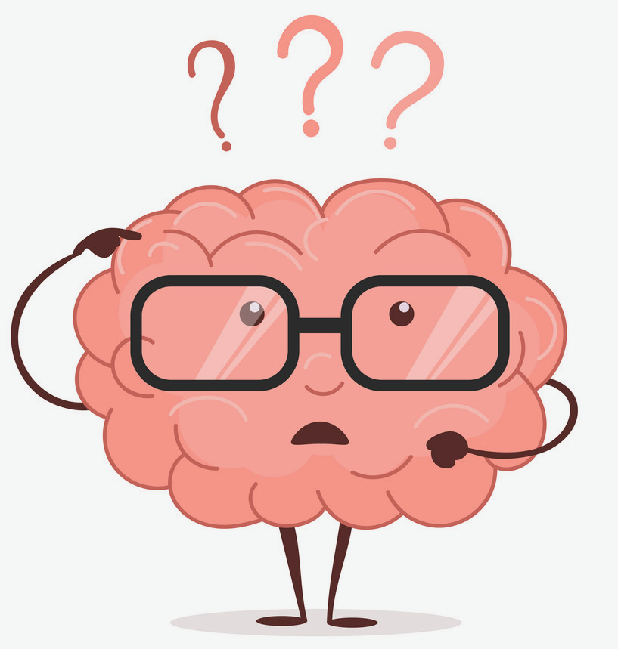
What is Addiction?
Addiction is a primary, chronic disease of brain reward, motivation, memory and related circuitry. Dysfunction in these circuits leads to characteristic biological, psychological, social and spiritual manifestations. This is reflected in an individual pathologically pursuing reward and/or relief by substance use and other behaviors.
Addiction is characterized by inability to consistently abstain, impairment in behavioral control, craving, diminished recognition of significant problems with one’s behaviors and interpersonal relationships, and a dysfunctional emotional response. Like other chronic diseases, addiction often involves cycles of relapse and remission. Without treatment or engagement in recovery activities, addiction is progressive and can result in disability or premature death.

Slide 3


“I’m too young to get addicted…”
Addiction does not discriminate when it comes to age. Anyone who drinks or uses drugs runs the risk of becoming addicted. In fact, people who drink alcohol or use drugs at an early age are much more likely to develop an alcohol or substance use disorder.
Approximately 50% of teens have misused drugs (legal or illicit) at least once in their lifetime.

Slide 4
What are the most common drugs used by teens?

Slide 5
Common Drugs of Misuse
Opioids – Prescription Pain Relievers, Heroin, and more
1
Alcohol – Beer, liquor, wine
2
Marijuana - Joints, Vaporizers, Edibles, and others
3

Slide 6
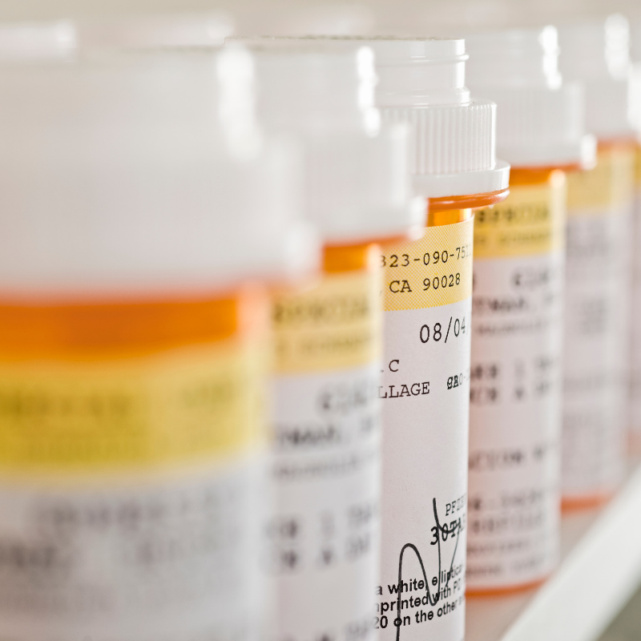
Opioids
Opioids can be prescribed and can also be illicit. You might not realize this, but if you have had a sports injury, dental work, or surgery, it is possible your doctor gave you a pain reliever that was actually an opioid medication. While opioids can be very effective at treating pain, they can be very addictive and should only be used under a doctor’s careful watch.
In addition to opioids given to you by a doctor, there is another kind of opioid you have probably heard about called heroin. Heroin is a very dangerous drug that is usually used by injecting it directly into a vein with a needle. The chemical makeup of heroin is the same as that of pain relievers and both can be very addictive and cause deadly opioid overdoses. In fact, 2.14 million people ages 12 and older had an opioid use disorder in 2016, including 153,000 12- to 17-year-olds.

Slide 7
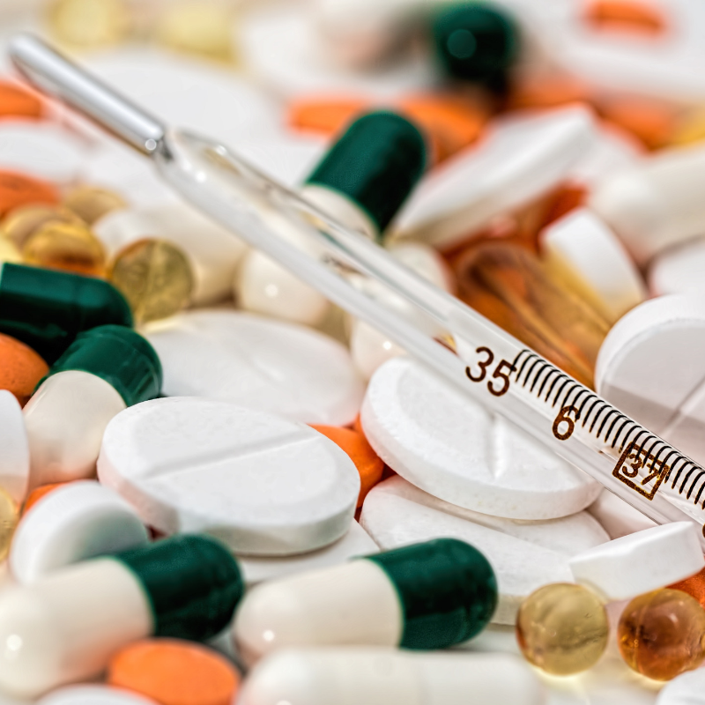
How Opioids Affect the Body and Brain – Short Term
Using drugs, especially early in life, can lead to poor grades, worse performance in sports, and bad relationships with friends and family. Opioids also alter judgment which can cause you to do risky things you wouldn’t ordinarily do, like having unprotected sex or getting into a car crash because you drove while under the influence of opioids.
In the short term, the release of dopamine into your body can make some people feel really relaxed and happy. But it can also cause more harmful effects, like extreme sleepiness, confusion, nausea, vomiting, and constipation. Over time, opioids can lead to insomnia, muscle pain, heart infections, pneumonia, and addiction.

Slide 8
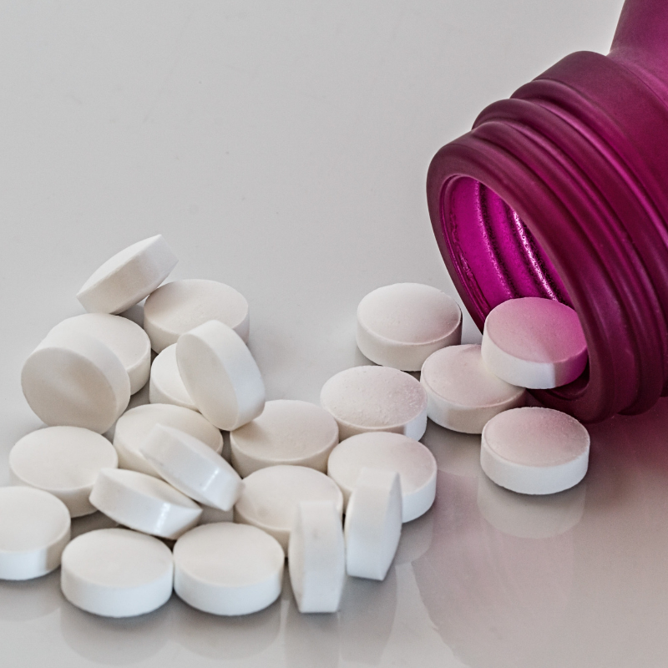
How Opioids Affect the Body and Brain – Short Term
Long-term effects can include:
Nausea and vomiting
Abdominal distention and bloating
Constipation
Liver damage (especially prevalent in abuse of drugs that combine opiates with acetaminophen)
Brain damage due to hypoxia, resulting from respiratory depression
Development of tolerance
Dependence
Death

Slide 9

Alcohol
People drink to socialize, celebrate, and relax. Alcohol often has a strong effect on people—and throughout history, people have struggled to understand and manage alcohol’s power. Why does alcohol cause people to act and feel differently? How much is too much? Why do some people become addicted while others do not?

Slide 10
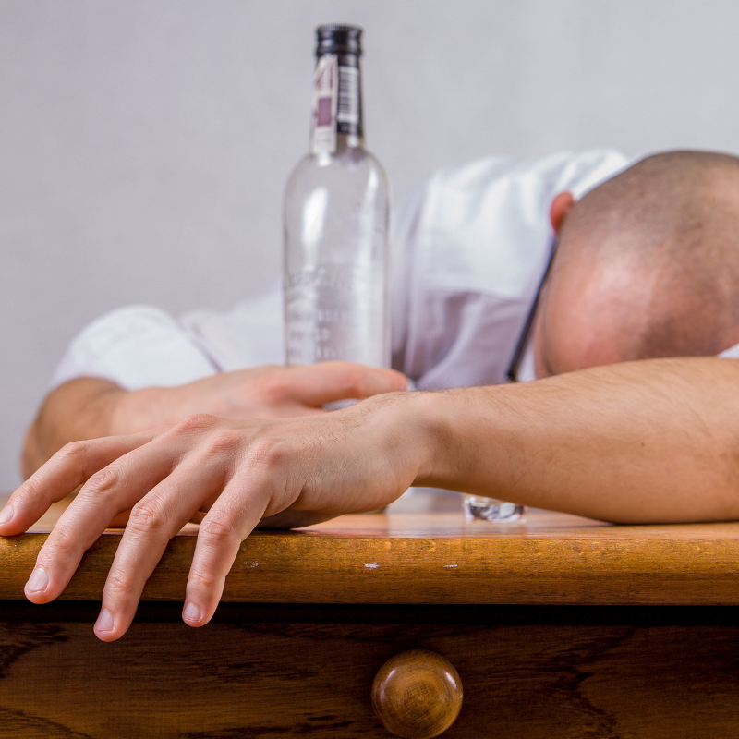
How Alcohol Affects the Body and Brain – Short Term
Alcohol enters your bloodstream as soon as you take your first sip. Alcohol’s immediate effects can appear within about 10 minutes. As you drink, you increase your blood alcohol concentration (BAC) level, which is the amount of alcohol present in your bloodstream. The higher your BAC, the more impaired you become by alcohol’s effects. These effects can include:
Reduced inhibitions
Slurred speech
Motor impairment
Confusion
Memory problems
Concentration problems
Coma
Breathing problems
Death

Slide 11

How Alcohol Affects the Body and the Brain – Long Term
Drinking too much – on a single occasion or over time – can take a serious toll on your health. Here’s how alcohol can affect your body:
Brain:
Alcohol interferes with the brain’s communication pathways, and can affect the way the brain looks and works. These disruptions can change mood and behavior, and make it harder to think clearly and move with coordination.
Heart:
Drinking a lot over a long time or too much on a single occasion can damage the heart, causing problems including:
Cardiomyopathy – Stretching and drooping of heart muscle
Arrhythmias – Irregular heart beat
Stroke
High blood pressure
Liver:
Heavy drinking takes a toll on the liver, and can lead to a variety of problems and liver inflammations including:
Steatosis, or fatty liver
Alcoholic hepatitis
Fibrosis
Cirrhosis
Pancreas:
Alcohol causes the pancreas to produce toxic substances that can eventually lead to pancreatitis, a dangerous inflammation and swelling of the blood vessels in the pancreas that prevents proper digestion.

Slide 12
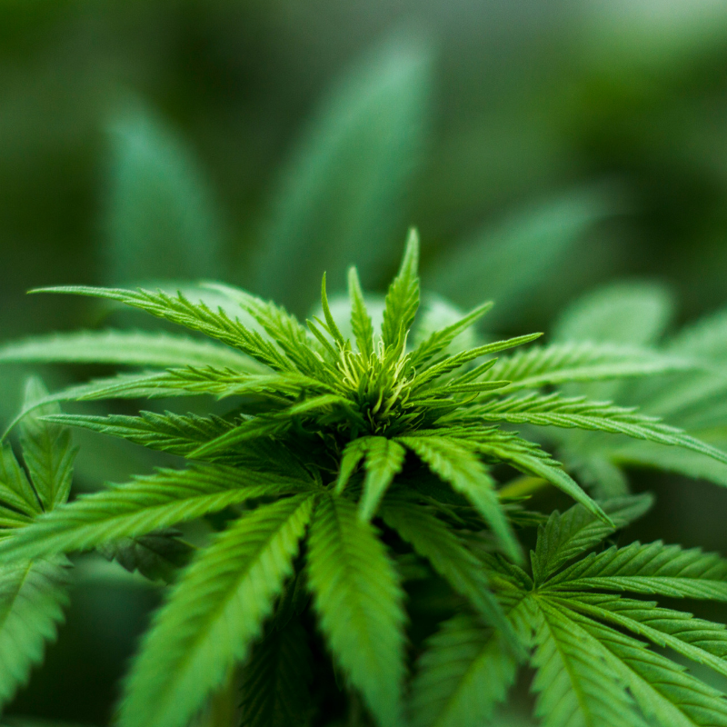
Marijuana
Marijuana can be addictive. Not everyone who uses marijuana will become addicted. Becoming addicted to drugs depends on a lot of factors, including the genes you were born with, the age you start using, how easily you can access the drug, your home and family life, your peers, and so on. Repeated marijuana use can lead to a marijuana use disorder. The most severe form is known as addiction. Addiction means that you have trouble controlling your drug use even if it’s causing bad things to happen. About 11 percent of people who use marijuana in a given year may have a drug problem. Those who begin using marijuana before age 18 are four to seven times more likely than adults to develop a drug problem

Slide 13
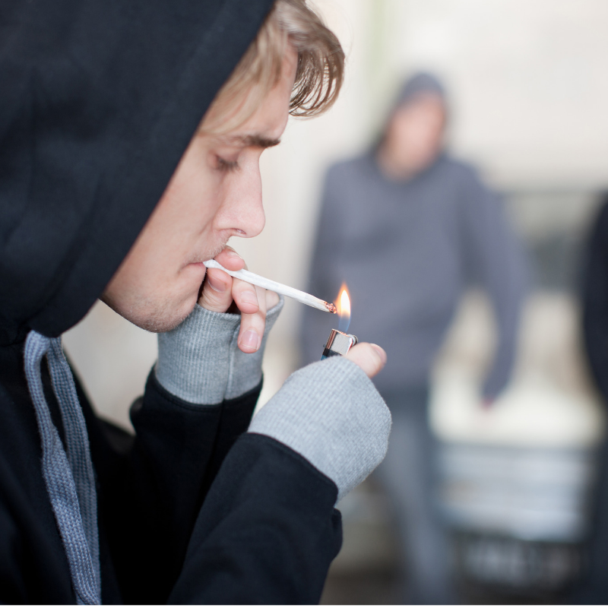
The Risks of Marijuana Use
Research shows that marijuana affects safe-driving skills, like judgment, coordination, and reaction time. Marijuana makes it hard to judge distances and react to signals and sounds on the road. As with any psychoactive drug, impaired driving can cause deadly vehicle crashes.
Marijuana is linked to problems in school. Marijuana dulls your attention, memory, and learning skills.
Long-term effects (effects of repeated use)
Risk of marijuana addiction
Long-term learning and memory problems if heavy use begins during youth
Risk for chronic cough, bronchitis
Risk of schizophrenia in some people with higher genetic risk
In rare cases, risk of recurrent episodes of severe nausea and vomiting

Slide 14

Mental Health & Addiction
In 2014, 20.2 million adults in the U.S. had a substance use disorder and 7.9 million had both a substance use disorder and another mental illness. More than half of the people with both a substance use disorder and another mental illness were men (4.1 million). Having two illnesses at the same time is known as “comorbidity” and it can make treating each disorder more difficult.

Slide 15

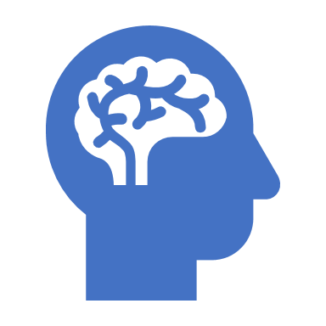
Common Mental Illnesses
Mental Illness can affect anyone of any age. Some of the most common mental illnesses can begin to manifest during teen years:
Post Traumatic Stress Disorder (PTSD) which can often occur after a traumatic event like the death of a loved one, exposure to trauma like abuse, rape, sexual assault, and others.
Depression
Anxiety
Obsessive Compulsive Disorder (OCD)

Slide 16
Mental Illness & Addiction are not shameful
Often stigma (a mark of disgrace associated with a particular circumstance, quality, or person) can be associated with mental illness and substance abuse and can be a barrier to seeking assistance. If you, or someone you know, is struggling with a mental health or substance use issue, reach out to a trusted friend, family member or adult like a teacher, coach, or counselor.
Medications and treatment like therapy, anti-depressants, anxiolytics, can help to treat mental illness and reduce the likelihood of substance use as self-medication for disorders

Slide 17
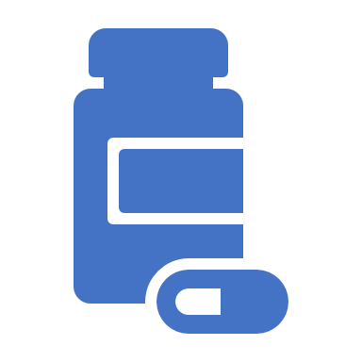
Addiction Treatment & Support
While addiction is considered a chronic disease that cannot be “cured” there is help for those struggling. Treatment for addiction(s) can include:
Individual Counseling
Group Therapy
Family Counseling
Residential or in-patient treatment
Outpatient Treatment
Medication-Assisted Treatment

Slide 18

Who We Are
We are doctors, therapists, case managers, social workers, chefs and more! From vastly different backgrounds, we came together with something in common: we’ve all been affected by addiction in some way, and we all want to build a healthier community. Each of us is wholeheartedly dedicated to supporting people who are working to overcome addiction and maintain a recovery lifestyle.
Our mission is to promote the overall health, wellness, and recovery of individuals impacted by substance use and behavioral health issues by meeting the treatment needs of our clients and community.

Slide 19
What We Offer
• The PIER - Detox for Drugs and Alcohol
• Residential Services for Men and Women
• Recovery Homes for Men and Women
• Outpatient Services
• Intensive Outpatient
• Assessments
• The PORCH - Community Resource Center
• Treatment Groups
• Therapy
• Medication-Assisted Treatment

Slide 20

Thank you!
Contact Me:
Kate Kerr, Director of Communications & Outreach
Addiction Treatment Services
1010 S. Garfield Ave., Traverse City, MI 49686
katek@addictiontreatmentservices.org
Phone: 231.346.5218 x 204 Mobile: 517.488.8940
www.addictiontreatmentservices.org

